Slide 1
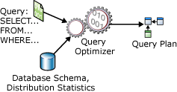
SQL, Query Processing and Optimization
Module No. 4 | SQL, Query Processing and Optimization
SQL, Steps in Query Processing, Transforming SQL queries to Relational Algebra, Heuristic Query Optimization.

Slide 2
Query
A query is a kind of request that is sent to the Database for retrieval of data.
In a query, we pass some specific condition, and then it matches the specific data if it is present in the database.
Write queries in SQL( Structured Query Language). This language is a way of communication between the user and the relational database.
Ex: Select * from employee where salary>10000;
A query can be simple or more complex. It completely depends on the complexity of the data.

Slide 3
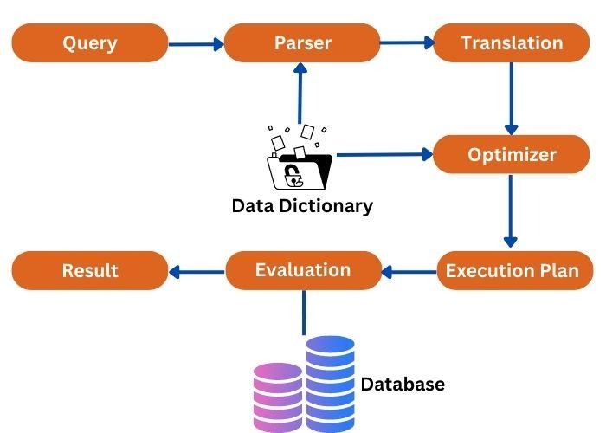
Query Processing
Query processing is a process of translating a user query into an executable form.
It helps to retrieve the results from a database. In query processing, it converts the high-level query into a low-level query for the database.
Query processing is a very important component of DBMS.

Slide 4
Query Processing
1. Parsing and Translation
Translate the query into its internal form.
This is then translated into relational algebra.
Parser checks syntax, verifies relations Translation-
Check SQL syntax – check the existence of relations and attributes
Replace views by their definitions – transform the query into an internal form (similar to relational algebra).
Query parsing is the first step in query processing. In this step, a query is checked for syntax errors. Then it converts it into the parse tree. So, a parse tree represents the query in a format that is easy to understand for DBMS. A parse tree is used in other steps of query processing in DBMS.

Slide 5
Query Processing
2. Optimization
Generate alternative access plans, i.e., procedure, for processing the query
Select an efficient access plan.
After doing query parsing, the DBMS starts finding the most efficient way to execute the given query. The optimization process follows some factors for the query.
These factors are indexing, joins, and other optimization mechanisms.
These help in determining the most efficient query execution plan. So, query optimization tells the DBMS what the best execution plan is for it.
The main goal of this step is to retrieve the required data with minimal cost in terms of resources and time.

Slide 6
Query Processing
3. Evaluation
The query-execution engine takes a query-evaluation plan, executes that plan, and returns the answers to the query.
After finding the best execution plan, the DBMS starts the execution of the optimized query. And it gives the results from the database.
In this step, DBMS can perform operations on the data. These operations are selecting the data, inserting something, updating the data, and so on.
Once everything is completed, DBMS returns the result after the evaluation step. This result is shown to you in a suitable format.

Slide 7
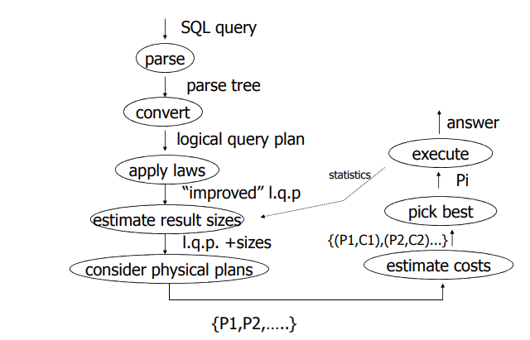
Query Processing

Slide 8
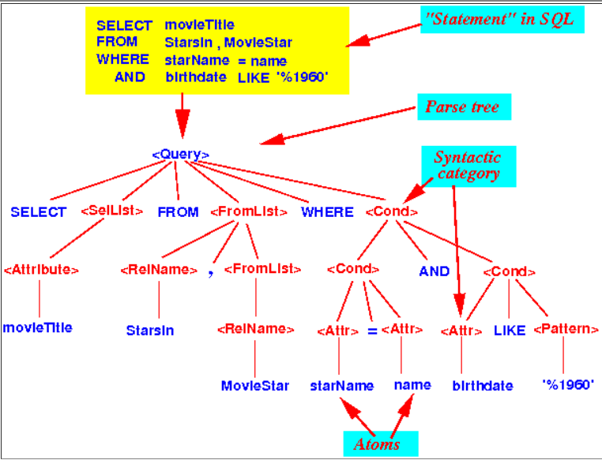
Query Processing
Example of Query Processing
Parse tree = a tree whose nodes correspond to
Atoms of the programming language or
Syntactic categories of the programming language

Slide 9
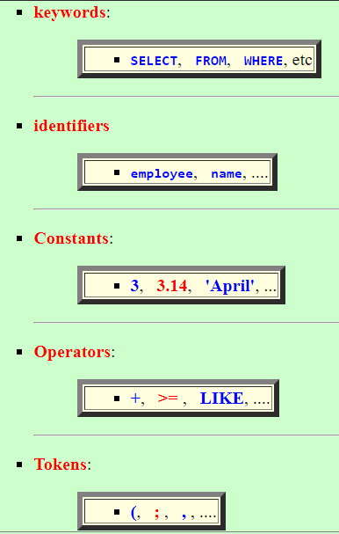
Query Processing
Example of Query Processing
Atom
A lexical element in a (programming) language that cannot be expressed in more elementary lexical elements.
Examples of atoms

Slide 10
Query Processing
Example of Query Processing
Syntactic category
a lexical construct in a (programming) language that is built up with other lexical elements some syntactic rules.
Examples of syntactic categories
<Query>
<Arithmetic expression>
<Condition> (or Boolean expression)

Slide 11
Query Processing
Some simple attempts to improve DBMS effectiveness
Creating Index
Index can increase the speed on search records. In creating the index, index key fields are specified based on fields that are often accessed by clauses: Where, Join, Order By, Group By.
2. Determining the Right Data Type
For example using data type of char and varchar. Both types of data can accommodate characters. The char provides a fixed storage size (fixed length), while the varchar provides the storage size by the contents of the data (variable length).
3. Avoiding Fields of Null Value
The null value is sometimes confused in the programmer's interpretation and may result in programming logic errors.
4. Avoiding the SELECT * operations
5. Restrict the ORDER BY operation

Slide 12
Query Processing
Some simple attempts to improve DBMS effectiveness
6. Using Subquery or JOIN
It is recommended to prioritize the use of JOIN operations, because in the general case, it will result in faster performance. But if in certain cases can only be solved with subquery, then use subquery.
7. Using WHERE in SELECT
WHERE clause is used as a condition to filter records so that it can minimize the load of data traffic, because not all records are accessed.
8. Consider the operator's access speed
The fastest processed operator sequence is =, >, >=, <=, Like, <>.

Slide 13
Query Optimization
Steps for the Query Optimization Process
Determining Query Plan
The query plan is written using relational algebra. The creation of a query plan is based on a query tree (expression tree) that contains a sequence of relational operations.
2. Transform the query plan by using equivalence rules
Rules equivalence is used to transform the query plan into the optimized query :
a. Creating the query tree (expression tree)
b. Determining the relational algebra
c. Evaluating the output and the number of tuples and columns involved
d. Repeating step a until the optimized query is obtained

Slide 14


Query Optimization
Equivalence Rules
An equivalence rule says that expressions of two forms are equivalent. We can replace an expression of the first form by an expression of the second form or vise versa-- since the two expressions generate the same result on any valid database
1. Conjunctive selection operations can be deconstructed into a sequence of individual selections
2. Selection operations are commutative
3. Only the final operations in a sequence of projection operations are needed; the others can be omitted

Slide 15
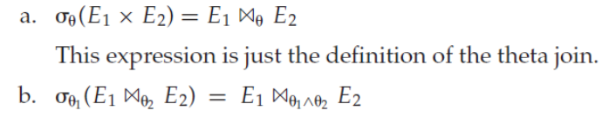


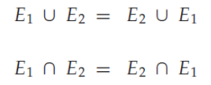

Query Optimization
Equivalence Rules
4. Selections can be combined with Cartesian products and theta joins
5. Theta-join operations are commutative
6. Natural-join operations are associative
7. The set operations union and intersection are commutative.

Slide 16
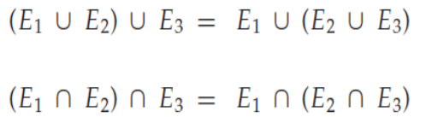


Query Optimization
Equivalence Rules
8. Set union and intersection are associative
9. The selection operation distributes over the union, intersection, and set difference operations
10. The projection operation distributes over the union operation.

Slide 17
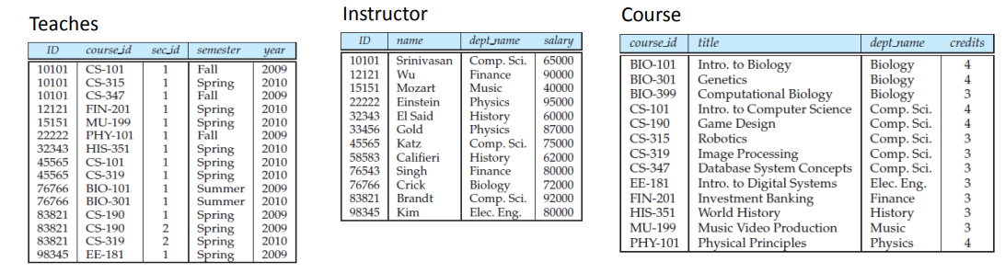
Query Optimization
Example
Query: “Find the names of all instructors in the Music department together with the course title of all the courses that the instructors teach.”

Slide 18
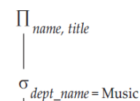
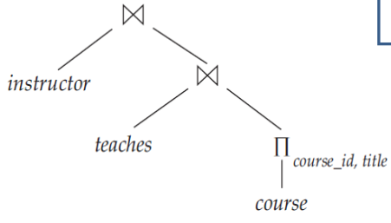

Query Optimization
Example
Find the names of all instructors in the Music department together with the course title of all the courses that the instructors teach.”
Step 1
Determining the query plan by using relational algebra based on the expression tree
Relational Algebra
Initial expression tree

Slide 19
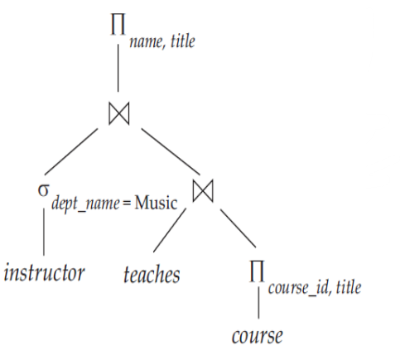

Query Optimization
Example
Step 2 :
Transform the query plan into the optimize query by using Equivalence Rules.
In this case, the query plan can be optimized using equivalence rules number 6 (Natural-join operations are associative).
Determining the query plan by using relational algebra based on the expression tree
Relational Algebra
The next step :
output and process analysis of query plan and optimize query
Transformed expression tree

Slide 20
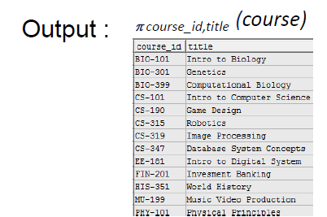
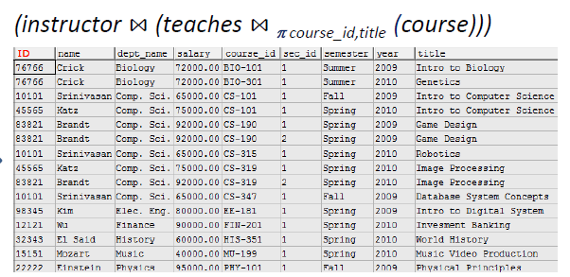
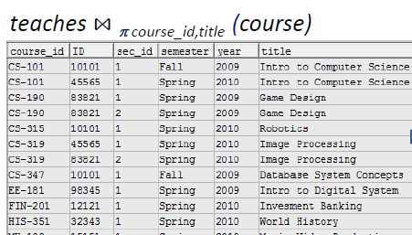
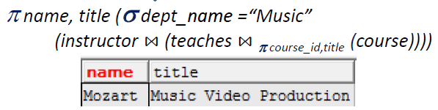
Query Optimization
Example
Step 3 :
Output and process analysis of the query plan and the optimize query.
Query plan:

Slide 21
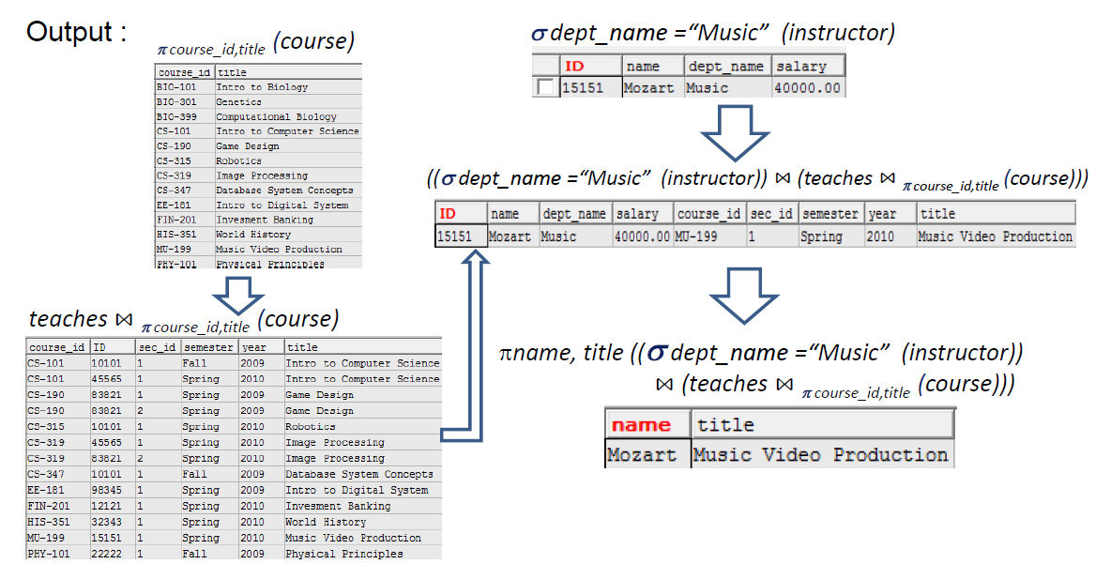
Query Optimization
Step 4 :
Output and process analysis of the query plan and the optimize query.
The Optimize Query

Slide 22
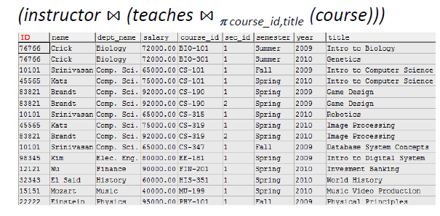
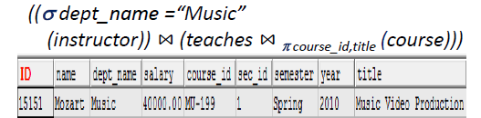
Query Optimization
Analysis Results
Output analysis: The query plan and the optimize query produces the same output.
Process analysis: The natural join operation of the optimize query is producing a smaller number of tuples than natural join operation of the query plan.
Optimize query
Query plan
The result of the query above needs the optimize process by reducing the columns are not required (dept_name, salary, etc).

Slide 23
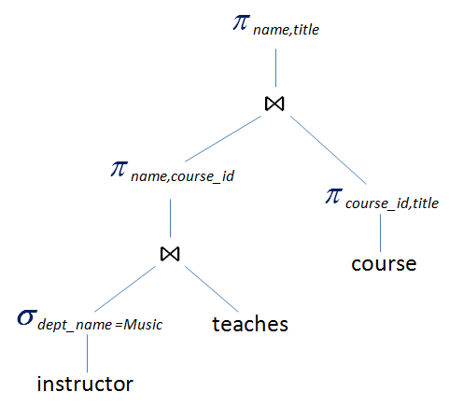
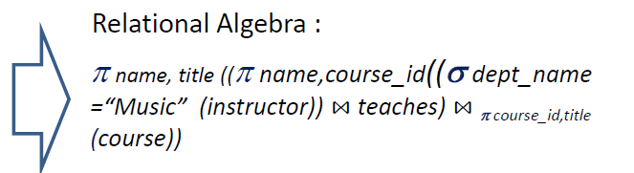
Query Optimization
The next step
The query optimization process is used to reduce the columns are not required. Therefore, the expression tree is formulated as follows
Determining the optimized query by using relational algebra based on expression tree
The next step :
output and process analysis of the previous optimized query and the optimize query.
Transformed expression tree

Slide 24

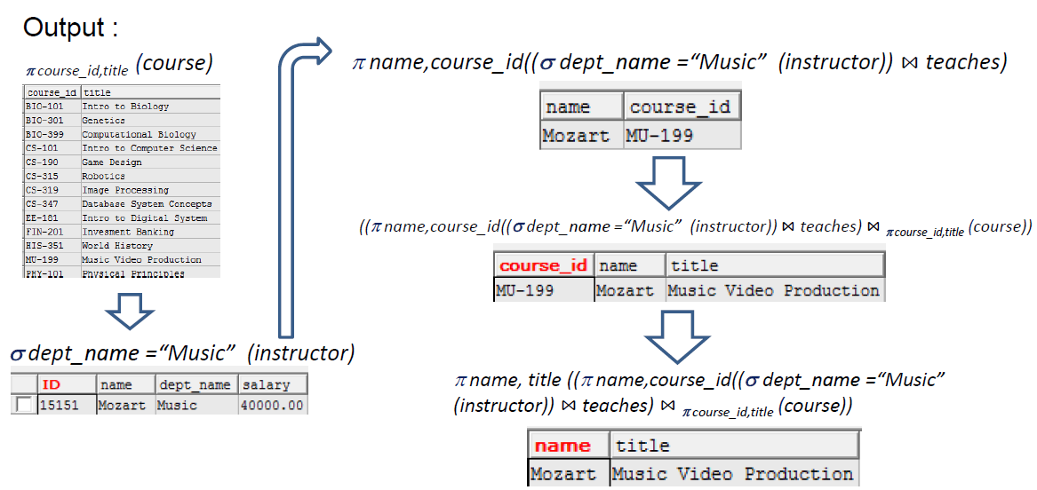
Query Optimization
Output and process analysis of the optimized query

Slide 25



Query Optimization
Output analysis : the previous optimized query and the optimized query produces the same output
Process analysis: The natural join operation of the optimized query produces a smaller number of columns than the natural join operation of the previous optimized query.
The previous optimized query
The result of the optimized query

Slide 26
Query Optimization
Purpose of SQL Query Optimization
1. Reduce Response Time: The major goal is to enhance performance by reducing the response time. The time difference between users requesting data and getting responses should be minimized for a better user experience.
2. Reduced CPU execution time: The CPU execution time of a query must be reduced so that faster results can be obtained.
3. Improved Throughput: The number of resources to be accessed to fetch all necessary data should be minimized. The number of rows to be fetched in a particular query should be in the most efficient manner such that the least number of resources are used.

Slide 27
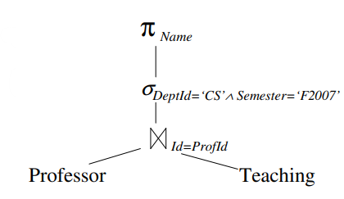
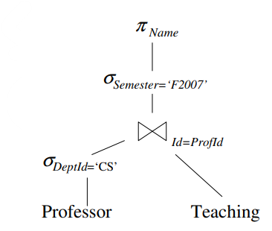
Query Optimization
Example 2:
SELECT P.Name FROM Professor P, Teaching T
WHERE P.Id = T.ProfId AND P. DeptId = ‘CS’ AND T.Semester = ‘F2007’
Relational algebra
The initial expression tree
Optimized query Relational algebra
Transformed expression tree

